Slide 1
Query Implementation using
B+ Trees

Slide 2
Objective
  We should use B+ Trees and
  It must be capable of holding one million elements
  Max it can take 100 accesses to fetch an element
  We have develop queries for =, <, > and for Updating
  We have to use Multiprocessing or threading concepts
  We have to use g++ on Linux

Slide 3
What is B+Tree
• A dynamic index structure that adjusts gracefully to inserts and deletes
• A balanced tree
• Leaf pages are not allocated sequentially. They are linked together through pointers and linked list

Slide 4
B+Tree 0f order 4
Root
7000
5
15
40
2000
5000
1000
4000
3
4
5
10
11
15
20
30
40
50
60
70
o
“John”
“srikanth”
“Raju”
“sridhar”
“Arun”
“karthik”
“Ram”
“Anu”
“kiran”
“Priyanka”
“Sneha”
“sunitha”

Slide 5
Data is saved in the leaves
The maximum number of pointers in a record is called the order of the B+ tree.
The minimum number of keys per record is 1/2 of the maximum number of keys.

Slide 6
For a n-order B+ tree with a height of h:
Maximum number of keys is
n power h
Minimum number of keys is
2 [(n / 2) power (h − 1. )]

Slide 7
INSERTION
Root
7000
5
15
40
2000
5000
1000
4000
3
4
5
10
11
15
20
30
40
50
60
70
0
“John”
“srikanth”
“Raju”
“sridhar”
“Arun”
“karthik”
“Ram”
“Anu”
“kiran”
“Priyanka”
“Sneha”
“sunitha”

Slide 8
Inserting 12
12
Root
“Ratan”
7000
5
15
40
12 need to be inserted between 11 and 15
But no space there
2000
5000
1000
4000
3
4
5
10
11
15
20
30
40
50
60
70
0
“John”
“srikanth”
“Raju”
“sridhar”
“Arun”
“karthik”
“Ram”
“Anu”
“kiran”
“Priyanka”
“Sneha”
“sunitha”

Slide 9
Key 11 and address 6000 will be pushed to upper level
Node splitting
New node
Root
11
7000
5
15
40
6000
2000
5000
6000
1000
4000
3
4
5
10
11
12
15
20
30
40
50
60
70
0
“John”
“srikanth”
“Raju”
“Ratan”
“Arun”
“karthik”
“Ram”
“Anu”
“kiran”
“Priyanka”
“sridhar”
“Sneha”
“sunitha”

Slide 10
Node splitting
11
New node
Root
4000
7000
4000
5
11
15
40
2000
5000
6000
1000
4000
3
4
5
10
11
12
15
20
30
40
50
60
70
“John”
“srikanth”
“Raju”
“Ratan”
“Arun”
“karthik”
“Ram”
“Anu”
“kiran”
“Priyanka”
“sridhar”
“Sneha”
“sunitha”

Slide 11
After Insertion of 12
Root
New root Node
11
8000
11
4000
7000
4000
5
15
40
2000
5000
6000
1000
4000
3
4
5
10
11
12
15
20
30
40
50
60
70
“John”
“srikanth”
“Raju”
“Ratan”
“Arun”
“karthik”
“Ram”
“Anu”
“kiran”
“Priyanka”
“sridhar”
“Sneha”
“sunitha”

Slide 12
After Insertion of 12
Root
8000
11
7000
4000
5
15
40
2000
5000
6000
1000
4000
3
4
5
10
11
12
15
20
30
40
50
60
70
“John”
“srikanth”
“Raju”
“Ratan”
“Arun”
“karthik”
“Ram”
“Anu”
“kiran”
“Priyanka”
“sridhar”
“Sneha”
“sunitha”

Slide 13
Client 1
Server
Insertion
Parent Server
Deletion
Updating
Client 3
Other Queries
Insertion
B+ Tree Data Structure
1000000
Elements
Deletion
Updating
Client 2
Other Queries
Insertion
Deletion
Updating
Child Servers
Other Queries
Server processes

Slide 14
Technology used
Software:
G++ GNU C++ Compiler
GDB GNU Debugger
Electric Fence Library for illegal memory accesses in dynamic memory allocation
Red Hat Linux Fedora core 5
Concepts:
Multiprocessing using fork()
Multi threading using POSIX threads
Semaphores IPC for Synchronizing clients with database
Hardware:
Pentium Dual core and Atholon Dual core systems in Peer to peer networking with 512 MB of RAM And 100 MBPS NIC cards

Slide 15
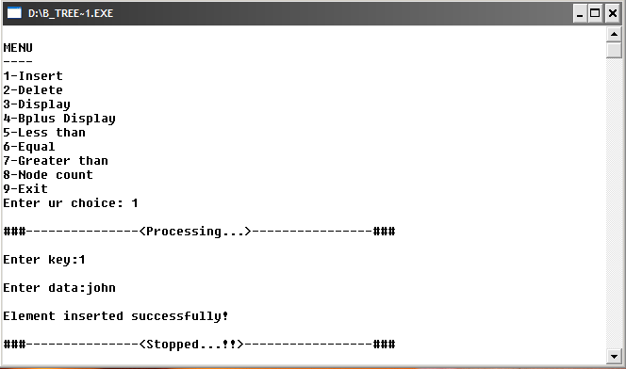

Slide 16
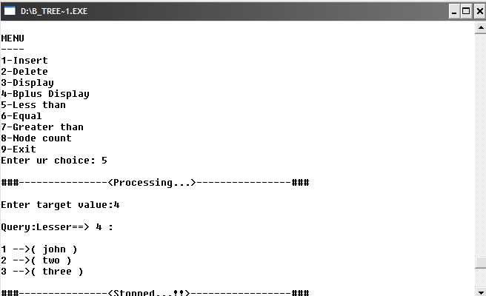

Slide 17
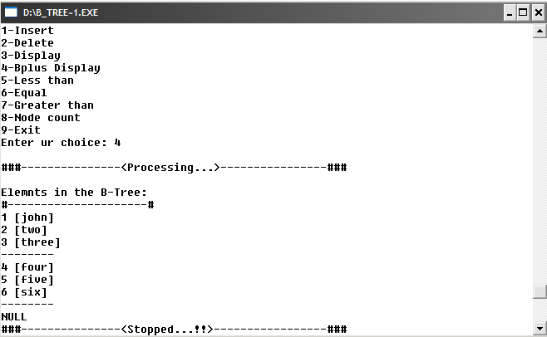

Slide 18
Test case
I used a test data generator routine which generates given number of Key->value pairs
I used 10000 elements as test data ,two Linux installed systems.
My objective is at maximum an element can be searched within 100 accesses, But i could do it with 32 accesses for 1 million elements.

Slide 19
ThanQ

